Slide 1

Crypto Prediction
Using Machine Learning to Predict Cryptocurrency Market Data

Slide 2

Reason for the Selected Topic
Due to dramatic changes in the world financial environment, cryptocurrencies have gained popularity as one of the alternative investment available to most. The volatility of cryptocurrency assets would pose a challenge to predict as there are multiple factors that influenced market data. Using Machine Learning, we hope to create a way to predict these crypto market data by studying the behavior of past data. We will assess and analyze historical data of six most popular cryptocurrencies and hope to compare the findings to real world market data.

Slide 3

Description of Data Source
Kaggle - the dataset contains historical trades on several crypto assets such as Bitcoin, Binance Coin, Etherium, Litecoin and Monero.
G-Research - is a quantitative finance research firm is Europe. They utilized machine learning, big data and the most advanced technology to predict movements in the financial markets.

Slide 4

Questions We Hope to Answer with Data
Which Machine Learning Model would best predict future price changes?
Which asset(s) is more stable out of the 6 cryptocurrencies chosen for prediction?
Which features affect the close price the most?

Slide 5
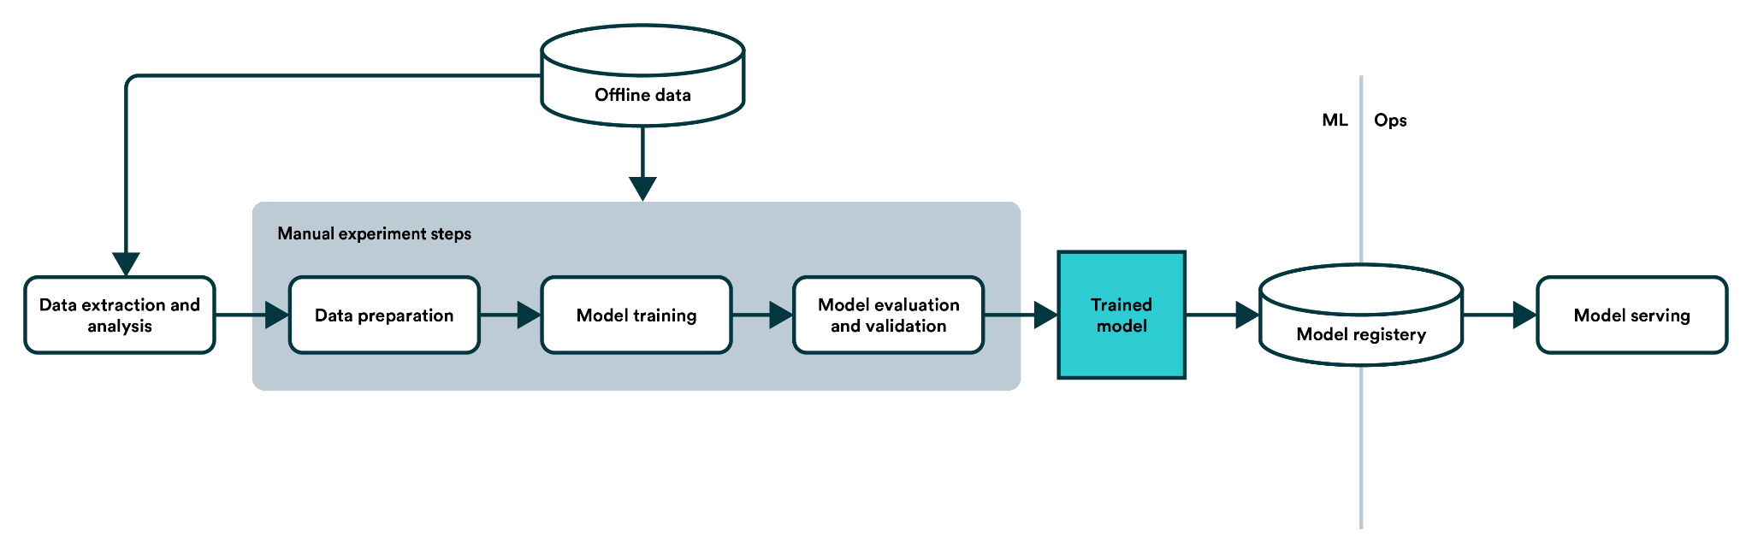
Process Map
Data Cleaning
Data Processing
Machine Learning
Optimization
Joining Datasets
Convert the minute-to-minute data to day-to-day data
Forward fill of missing dates in time series data
Filling NaN data
Manual split of training/testing set
Feature importances to determine best features
Split train/test for each asset of six chosen cryptocurrency
Linear Regression
Random Forest Regression
xGBooster Regression
RandomGridSearchCV to determine best parameter for HyperTuning
Artificial Neural Network

Slide 6





Tools and Resources Used
PostgreSQL
Amazon Web SErvices (AWS)
Jupyter Notebook
Tableau Public
Google Collab
Google Slides

Slide 7
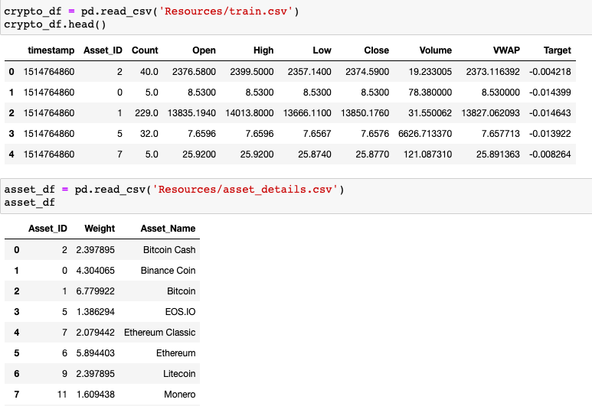
Data Exploration Phase
timestamp - A timestamp for the minute covered by the row.
Asset_ID - An ID code for the cryptoasset.
Count - The number of trades that took place this minute.
Open - The USD price at the beginning of the minute.
High - The highest USD price during the minute.
Low - The lowest USD price during the minute.
Close - The USD price at the end of the minute.
Volume - The number of cryptoasset units traded during the minute.
VWAP - The volume weighted average price for the minute.
Target - 15 minute residualized returns.

Slide 8
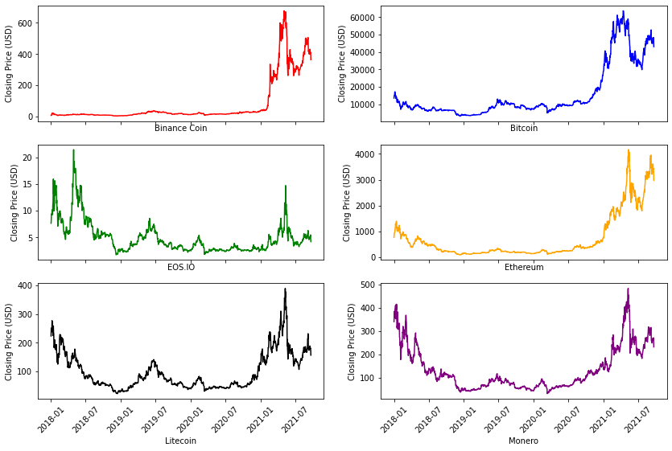
Analysis Phase
Closing price in USD of six chosen asset from 2018 to 2021

Slide 9
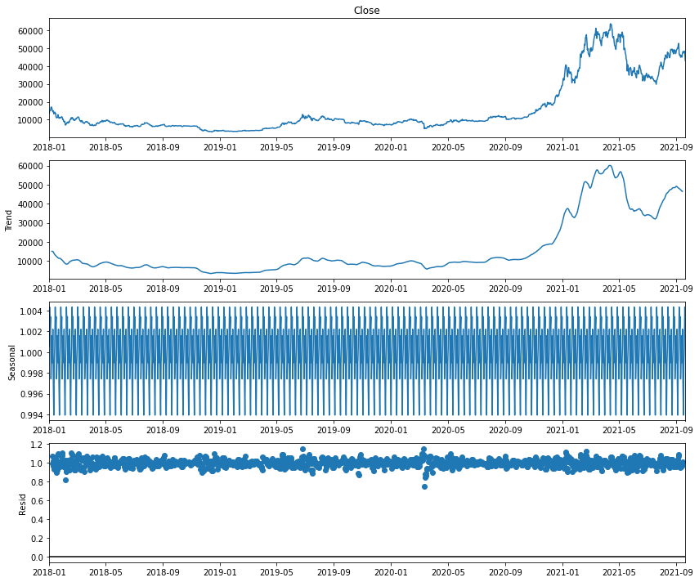
Analysis Phase cont
Time series analysis of Bitcoin to look at Trend, Seasonal and Residual data.

Slide 10
Analysis Results
Tableau Public Dashboard

Slide 11
Recommendations for Future Analysis
Use time series API for the forecasting portion of the analysis
Utilized library called Prophet and yfinance to pull real time data to make comparison to model prediction

Slide 12
Anything The Team Would Have Done Differently
Allocate time to explore time series forecasting, experiment with other libraries like Prophet and other ML models (LSTM, …)

